Slide 1
Three European retrospective real-world chart review studies to determine the effectiveness of flash glucose monitoring on HbA1c in adults with type 2 diabetes
Kröger J, et al. Diabetes Ther. 2020;11:279–291

Slide 2
Introduction
Evaluation of HbA1c levels is the primary means of assessing glycaemic control
It remains unclear if the use of flash glucose monitoring improves HbA1c levels in patients with type 2 diabetes receiving basal bolus insulin
Three parallel retrospective non-interventional chart review studies were conducted to assess the effect of FreeStyle Libre™ Flash Glucose Monitoring System on HbA1c in patients with insulin-treated type 2 diabetes in the real-world setting
HbA1c, glycated haemoglobin
Kröger J, et al. Diabetes Ther. 2020;11:279–291

Slide 3
FreeStyle Libre™ Flash Glucose Monitoring System
Factory calibrated sensor
Worn for up to 14 days without any need for calibration
Glucose data are automatically recorded and stored every 15 minutes
Real-time glucose levels can be obtained as often as required by scanning the sensor with the reader
Glucose reports can be generated from the sensor data for review by patients at home or in clinic with healthcare professionals
www.freestylelibre.com

Slide 4
Study design
Three retrospective non-interventional chart review studies were conducted in Austria, France and Germany (six centres in each country)
Inclusion criteria:
Patients with type 2 diabetes; ≥18 years old; receiving basal bolus insulin for ≥1 year; FreeStyle Libre™ use for ≥3 months; HbA1c of 8.0%–12.0% [64–108 mmol/mol] during ≤3 months before starting FreeStyle Libre™ use; HbA1c assessment 3–6 months after starting FreeStyle Libre™ use
Baseline HbA1c
Index date
HbA1c at 3–6 months
≤90 days
90–194 days
If multiple values available, value closest to index date
If multiple values available, value closest to 135 days
Date when patient started using FreeStyle Libre™
HbA1c, glycated haemoglobin
Kröger J, et al. Diabetes Ther. 2020;11:279–291

Slide 5
Outcomes
The primary endpoint was the change in HbA1c from baseline to 3–6 after starting FreeStyle Libre™ use
The primary endpoint was analysed in the following subgroups:
Baseline HbA1c <75 mmol/mol [9.0%] vs ≥75 mmol/mol [9.0%]
Age <65 years vs ≥65 years
Male vs female
Insulin use for <9 years vs ≥9 years
BMI <30 vs ≥30 kg/m²
Insulin administered as MDI vs by pump (French study only)
≤3 vs >3 average SMBG tests per day at baseline (French study only)
BMI, body mass index; HbA1c, glycated haemoglobin; MDI, multiple daily injections; SMBG, self-monitoring of blood glucose
Kröger J, et al. Diabetes Ther. 2020;11:279–291

Slide 6
Participants
Total records: 118
Austria
Primary analysis: 92
♂ 50 / ♀ 42
Excluded: 26
A total of 428 records were collected
Total records: 97
France
Primary analysis: 88
♂ 50 / ♀ 38
Excluded: 9
363 were included in primary endpoint analysis
♂ 204 / ♀ 158†
65 were excluded*
Total records: 213
Germany
Primary analysis: 183
♂ 104 / ♀ 78
Excluded: 30
*Reasons for exclusion: did not meet inclusion criteria (n=8), did not have HbA1c within 90 days of starting FreeStyle Libre™ (n=18), did not have HbA1c 3–6 months after starting FreeStyle Libre™ (n=39)
†Information available for 362 patients
Kröger J, et al. Diabetes Ther. 2020;11:279–291

Slide 7
Baseline characteristics
 | Austria (n=92) | France (n=88) | Germany (n=183)
Male/female, n (%) | 50 (54.3)/42 (45.7) | 50 (56.8)/38 (43.2) | 104 (57.1)/78 (42.9)
Age, years
Mean ± SD | 64.4 ± 9.7 | 64.4 ± 10.6 | 62.7 ± 11.8
Median (range) | 65.5 (32, 85) | 66 (27, 85) | 63 (28, 86)
<65 years, n (%) | 43 (46.7) | 40 (45.5) | 95 (51.9)
≥65 years, n (%) | 49 (53.3) | 48 (54.5) | 88 (48.1)
BMI, kg/m²
Mean ± SD | 30.8 ± 5.5 | 32.9 ± 5.5 | 33.8 ± 6.9
Median (range) | 29.7 (19.8, 48.8) | 32.1 (22.3, 45.7) | 33.4 (21.0, 77.7)
Duration of insulin use, years
Mean ± SD | 7.6 ± 5.6 | 9.9 ± 6.4 | 7.8 ± 5.4
Median (range) | 6.0 (1, 21) | 9.0 (1, 28) | 6.5 (1, 27)
BMI, body mass index; HbA1c, glycated haemoglobin; SD, standard deviation
Kröger J, et al. Diabetes Ther. 2020;11:279–291

Slide 8
Mean ± SD HbA1c at baseline and after 3–6 months of FreeStyle Libre™ use
*
*
*
*
*p<0.0001 vs baseline
HbA1c, glycated haemoglobin; SD, standard deviation
Kröger J, et al. Diabetes Ther. 2020;11:279–291

Slide 9
Mean (95% CI) change in HbA1c from baseline to 3–6 months
*
*
*
*
*p<0.0001 vs baseline
CI, confidence interval; HbA1c, glycated haemoglobin
Kröger J, et al. Diabetes Ther. 2020;11:279–291

Slide 10
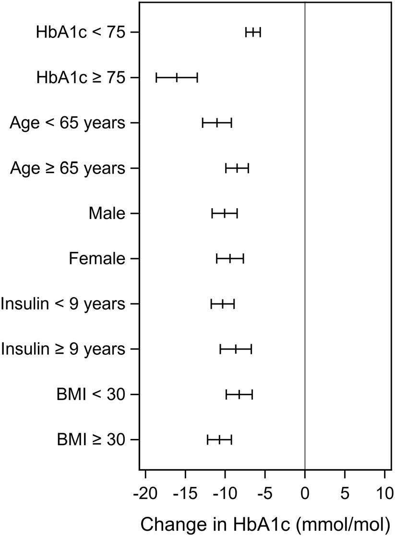
Subgroup analysis of the primary endpoint
Decrease in HbA1c levels was not significantly different in subgroups based on age (p=0.2767), sex (p=0.5990), duration of insulin use (p=0.2389) or BMI (p=0.0785)
Baseline HbA1c ≥ 75 mmol/mol was associated with significantly greater reductions in HbA1c versus HbA1c < 75 mmol/mol
Change in HbA1c (mmol/mol, mean and 95% CI)
BMI, body mass index; CI, confidence interval; HbA1c, glycated haemoglobin
Kröger J, et al. Diabetes Ther. 2020;11:279–291

Slide 11
Additional subgroup analysis of the primary endpoint (French study only)
 | N | Mean ± SD HbA1c, mmol/mol |  |  | 95% CI | p
 |  | Baseline | 3–6 months | Change
Method of insulin administration
MDI | 66 | 74.4 ± 9.9 | 66.8 ± 12.7 | –7.7 ± 12.4 | (–10.7, –4.6) | <0.0001
Pump | 21 | 74.8 ± 8.8 | 63.5 ± 11.6 | –11.3 ± 11.2 | (–16.4, –6.2) | 0.0001
MDI vs Pump |  |  |  |  |  | 0.2093
Average number of SMBG tests per day at baseline
≤3 | 33 | 75.2 ± 10.6 | 65.2 ± 14.7 | –10.0 ± 15.2 | (–15.4, –4.6) | 0.0006
>3 | 10 | 71.7 ± 6.3 | 67.5 ± 8.0 | –4.2 ± 7.4 | (–9.5, 1.1) | 0.0998
CI, confidence interval; HbA1c, glycated haemoglobin; MDI, multiple daily injections; SD, standard deviation; SMBG, self-monitoring of blood glucose
Kröger J, et al. Diabetes Ther. 2020;11:279–291

Slide 12
Limitations
Uncontrolled observational studies
Observations may be influenced by changes in insulin or other diabetes medication, which were largely unknown, but likely as HbA1c improved
Patients in whom diabetes was managed using FreeStyle Libre™ may have had more contact with HCPs
Limited availability of baseline data on demographics, disease variables, and socioeconomic status
Use of same HbA1c measurement for inclusion and baseline means the analysis is susceptible to regression to the mean
HCP, healthcare professional
Kröger J, et al. Diabetes Ther. 2020;11:279–291

Slide 13
Conclusion
In the real-world setting, the use of the FreeStyle LibreTM Flash Glucose Monitoring System significantly reduced HbA1c levels over a 3–6-month period in patients receiving basal-bolus insulin
HbA1c, glycated haemoglobin
Kröger J, et al. Diabetes Ther. 2020;11:279–291

