Slide 1
The impact of flash glucose monitoring on glycaemic control as measured by HbA1c: a meta-analysis of clinical trials and real-world observational studies
Evans M, et al. Diabetes Ther. 2020;11:83–95

Slide 2
Introduction
Reductions in HbA1c are associated with clinically relevant reductions in microvascular complications and long-term rates of macrovascular disease in patients with diabetes
Data on reductions in HbA1c during use of the FreeStyle Libre™ Flash Glucose Monitoring System in clinical trials are inconclusive
This meta-analysis of real-world studies determined the impact of the FreeStyle Libre™ Flash Glucose Monitoring System on glucose control in patients with diabetes
HbA1c, glycosylated haemoglobin.
Evans M, et al. Diabetes Ther. 2020;11:83–95

Slide 3
FreeStyle Libre™ Flash Glucose Monitoring System
Factory calibrated sensor
Worn for up to 14 days without any need for calibration
Glucose data are automatically recorded and stored every 15 minutes
Real-time glucose levels can be obtained as often as required by scanning the sensor with the reader
Glucose reports can be generated from the sensor data for review by patients at home or in clinic with healthcare professionals
www.freestylelibre.com

Slide 4
Study design
This meta-analysis included 29 studies reporting HbA1c data in patients with T1D or T2D using the FreeStyle Libre™ system for 1–24 months
Exclusion criteria:
FreeStyle Libre system not used (also excluding FreeStyle Libre pro) (n=102)
New new data (excluding reviews, comments editorials, meta-analyses, protocol papers) (n=66)
No observed timeframe (excluding accuracy, case reports, inadequate observation time) (n=53)
Mixed data from several devices or further interventions, or unable to obtain minimum statistics (n=14)
No lab HbA1c (n=7)
TOTAL: n=242
Included studies
(n=29)
Longitudinal data available (n=25)
Unique citations identified from:
Initial database search (n=268)
Conference abstracts (n=2)
New publications (n=1)
TOTAL: n=271
Literature searching
Publication assessment
HbA1c, glycated haemoglobin; T1D, type 1 diabetes; T2D, type 2 diabetes
Evans M, et al. Diabetes Ther. 2020;11:83–95

Slide 5
Outcomes
Observed change in HbA1c at 2, 3 or 4 months in adult or paediatric subjects
Longitudinal analysis up to 12 months in adult subjects
HbA1c, glycated haemoglobin
Evans M, et al. Diabetes Ther. 2020;11:83–95

Slide 6
Participants
10 studies in children
19 studies in adults
A total of 29 studies including 2396 participants were included
All were using the FreeStyle Libre™ system
25 studies reported longitudinal data
Evans M, et al. Diabetes Ther. 2020;11:83–95

Slide 7
Baseline characteristics
Characteristic, n (%) | Patients (n=1723)
T1D | 1496 (87)
T2D | 227 (13)
Adults | 1723 (100)
T1D, type 1 diabetes; T2D, type 2 diabetes.
Evans M, et al. Diabetes Ther. 2020;11:83–95

Slide 8
Change from baseline in HbA1c at 2–4 months
Patient group | Absolute change (95% CI), %
Overall | –0.55 (–0.70, –0.39)
Adults | –0.56 (–0.76, –0.36)
Children | –0.54 (–0.84, –0.23)
There was a significant correlation between the change in HbA1c and HbA1c at baseline on regression analysis (slope, –0.31, SE 0.056, 95% CI –0.43 to – 0.19)
For each percentage increase in mean baseline HbA1c, the mean change in final HbA1c fell by 0.31%
CI, confidence interval; HbA1c, glycated haemoglobin; SE, standard error
Evans M, et al. Diabetes Ther. 2020;11:83–95

Slide 9
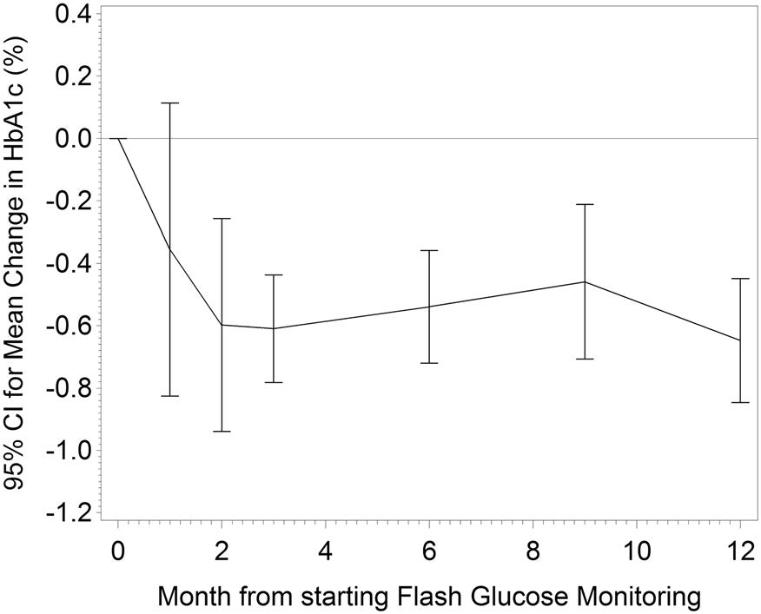
Longitudinal change in HbA1c
*
*
There were no significant differences in the change in HbA1c from baseline between patients with T1D or T2D
*
*
*
*Statistically significant reduction from baseline. HbA1c, glycated haemoglobin; T1D, type 1 diabetes; T2D, type 2 diabetes
Evans M, et al. Diabetes Ther. 2020;11:83–95

Slide 10
Limitations
Results based partly on data from observational studies with no control group
Eligibility criteria not standardised or explicitly stated, introducing the potential for recruitment bias
Potential for publication bias (i.e. the possibility that studies with negative or neutral findings have not been published)
Not all studies report how missing data were handled
Evans M, et al. Diabetes Ther. 2020;11:83–95

Slide 11
Conclusion
Starting flash glucose monitoring with the FreeStyle Libre™ system as part of daily diabetes care was associated with a significant reduction in HbA1c for adults and children with T1DM, and for adults with T2DM
Reductions in HbA1c in adults with T1D or T2D after starting to use the FreeStyle Libre™ system peaked after 2 months and were sustained for 1 year
HbA1c, glycated haemoglobin; T1D, type 1 diabetes; T2D, type 2 diabetes
Evans M, et al. Diabetes Ther. 2020;11:83–95

